Slide 1

PSTMetro
By Pascal Meyer, Thomas Nairn & Sean Rozario
Notes:
Welcome,
We are PSTMetro and today we are going to pitch to you our software program that we have produced for the people of Prague.

Slide 2
What was the problem?
Provide a model software solution for a route planner
Interactive Prague Metro system for general public
Commissioned by Prague City Council (PCC)
Notes:
The objective of this task was to create a journey planner for the Prague Metro system. This system allows a person with minimal technical ability to easily access and plan a journey through Prague. This project was authorized by the Prague City Council (PCC).

Slide 3
Description of the Model
Dijkstra’s Algorithm, shortest route using simple graph theory, we need to give it the following characteristics:
Simplistic, users will be able to navigate easily through the journey planner
Elegant, making the system aesthetically pleasing
Manageable, efficiently add different Metro Maps
Extendible, allow the addition of extra functionality
Notes:
Our goal was to create a system which is simple, elegant, manageable and expandable.
Simplistic: A minimal interface as to reduce the possibility of incorrect user input.
Elegant: Making the application appealing will ensure that the application is used over of its competitors.
Manageable: The application must be able to efficiently manage and add ‘Metro Systems’.
Extendible: The interface must be able to easily accommodate extra functionality that will not be included in the first iteration of the application.
We used a shortest path algorithm called Dijkstra’s.The algorithm would map the entire metro system and find the shortest paths to all other stations. This is efficient when the user of the application is trying to find the shortest path to a destination neighbouring two or more stations as the application would not have to re-compute the journeys.

Slide 4
Choice of Data Structures
Custom Lists, Lists are a data structure thats consists of a group of nodes, which together represent a sequence.
Custom Sets, A set is a collection that cannot contain duplicates.
Custom Maps, A Map is an object that maps keep values. A map cannot contain duplicate keys.
Notes:
Custom Lists- Lists are a data structure thats consists of a group of nodes, which together represent a sequence. Custom Sets- A set is a collection that cannot contain duplicates.
Custom Maps-A Map is an object that maps keep values. A map cannot contain duplicate keys.
The reason behind our decision to use customised maps, sets and lists, as our data structures, is so that the software is fully expandable. However, we decided that it was unnecessary to include these custom data structures throughout our program to increase efficiency and allow for an easily maintainable product for future java developers.

Slide 5
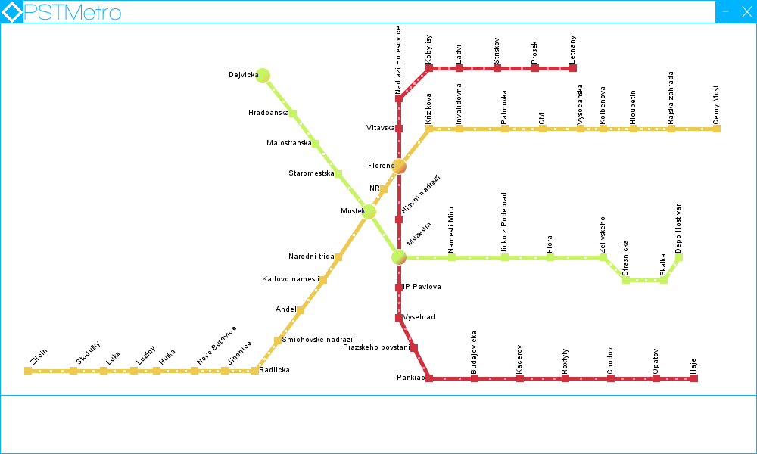
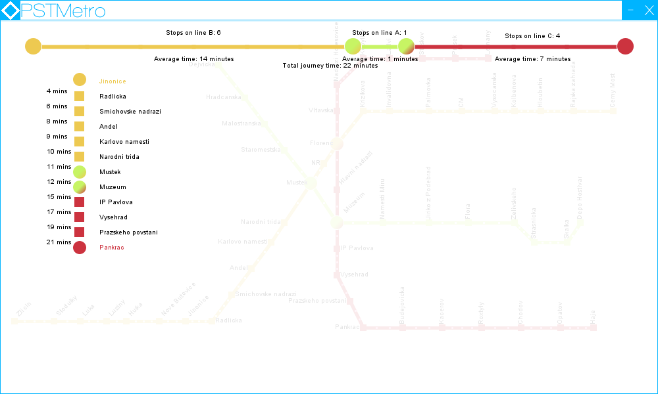
Using the Software
Figure 1
Figure 2
Notes:
To begin planning your journey simply click on the departure station. The station will appear in bottom left of the Journey page indicating that a station has been chosen. To complete the planning of a journey, the user must then click another station. The trip will form in the journey page as shown in “Figure 2”.
The Journey page will indicate the amount of changes required, along with times and stops per line. A colour change symbolizes a transition to another Metro Line. To select another journey, simply drag the journey page down.

Slide 6
Concluding Remarks & Reflection
Careful planning, this meant taking into consideration many situations involving user error and system specifics such as OS, platform and Metro features.
Interactivity, each member of the development team had several ideas on the way users could interact and manage the GUI, this resulted in a user friendly interface.
Styling, we implemented the Metro design language, a typography based scheme that both diminished our workload and gave the application a sense of identity using rich colors complimenting one-another.
Structure, perhaps the key element in creating an application with minimal alterations required during the implementation phase.
Notes:
As young developers we were keen to implement many ideas that were perhaps out of our reach due to many different reasons, such as time constraints and the lack of manpower. Were this not the case, here are some enhancements that we would have liked to accomplish:
Make a website dedicated to the journey planner
Password protection to allow customers to only plan journeys not edit
Tourist information on the surrounding area of each station situated in the city
Sponsorship & Advertising
Porting the current desktop application onto a mobile platform allowing journey planning on the go.
Usage of the Web API to enable real-time train information and train times
Additional features to the Metro API allowing for engineering works and other unplanned events that can occur in the real world.
Thank you for your time,
Are there any questions or comments.

